Slide 1









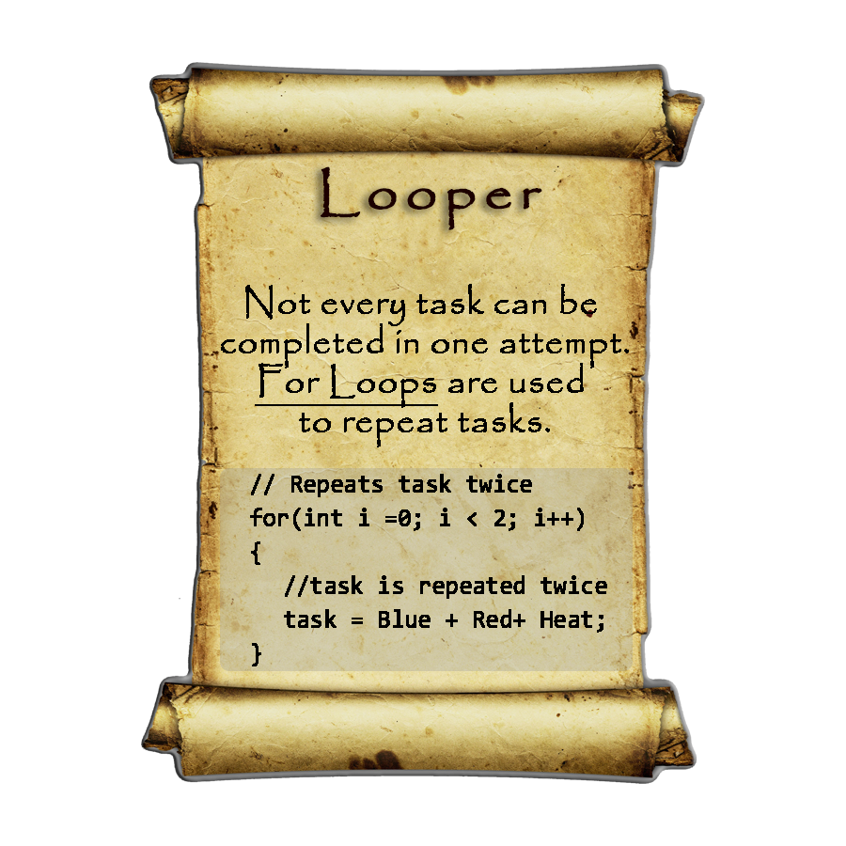
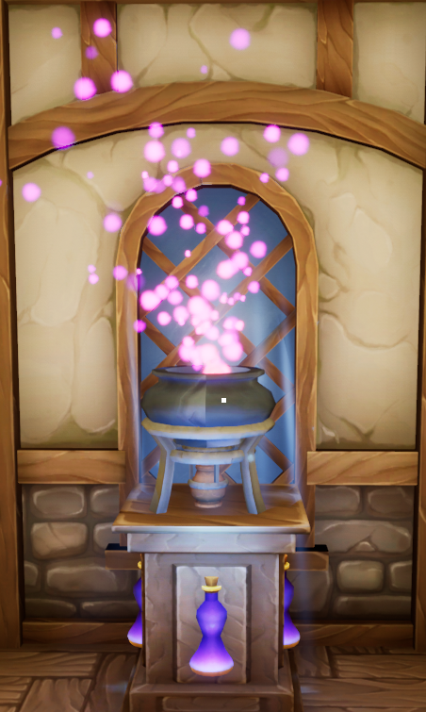
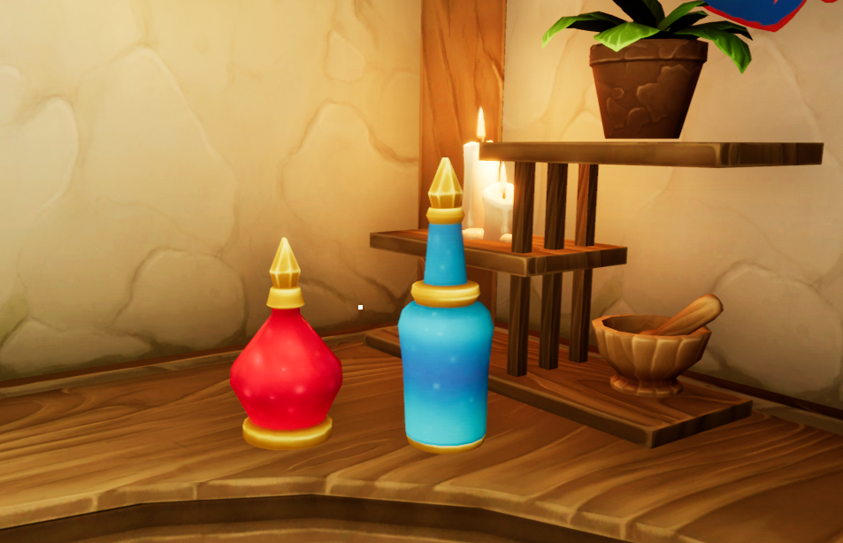
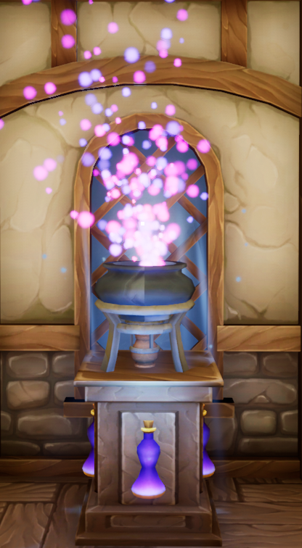
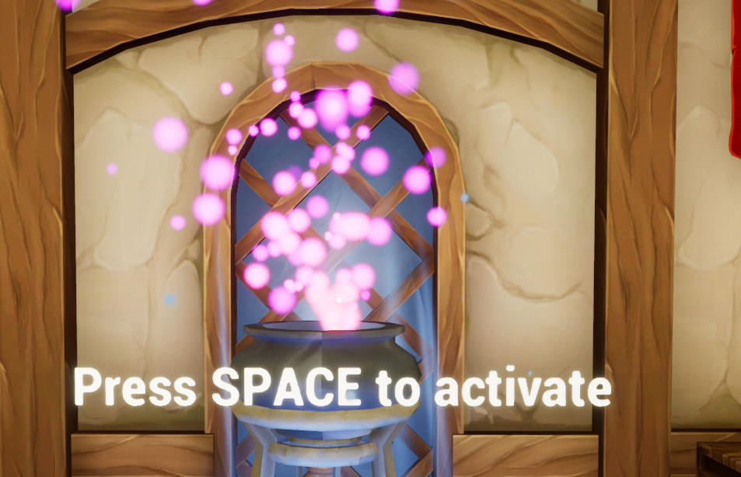
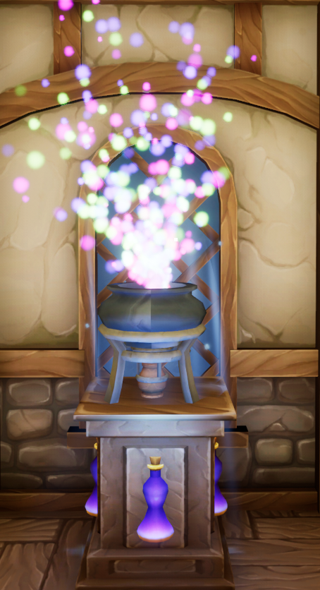
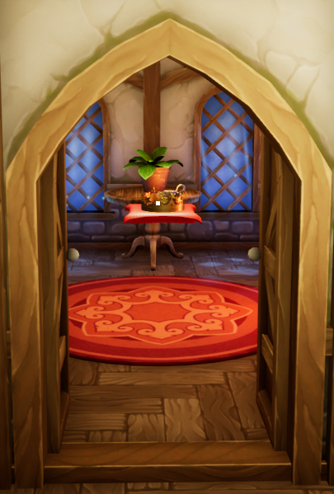
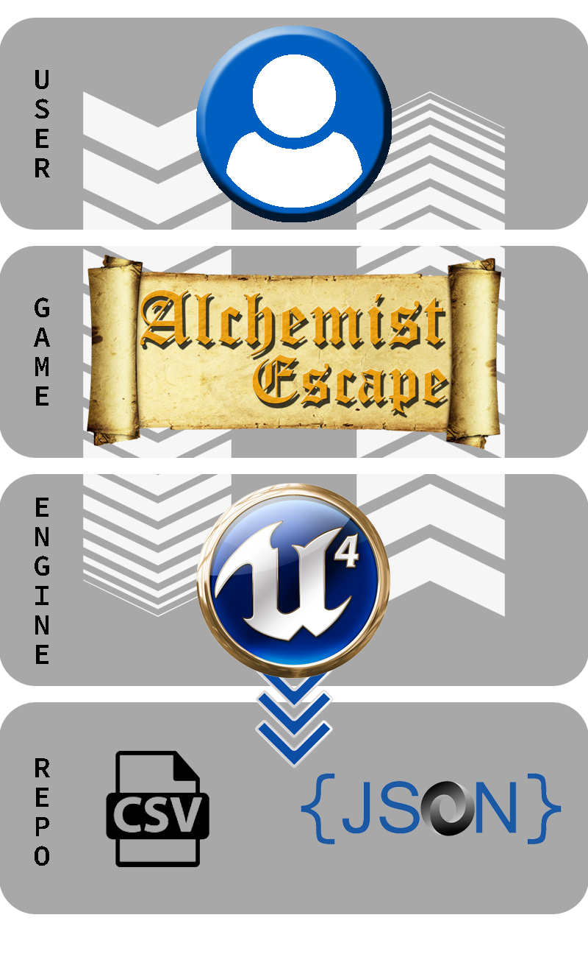
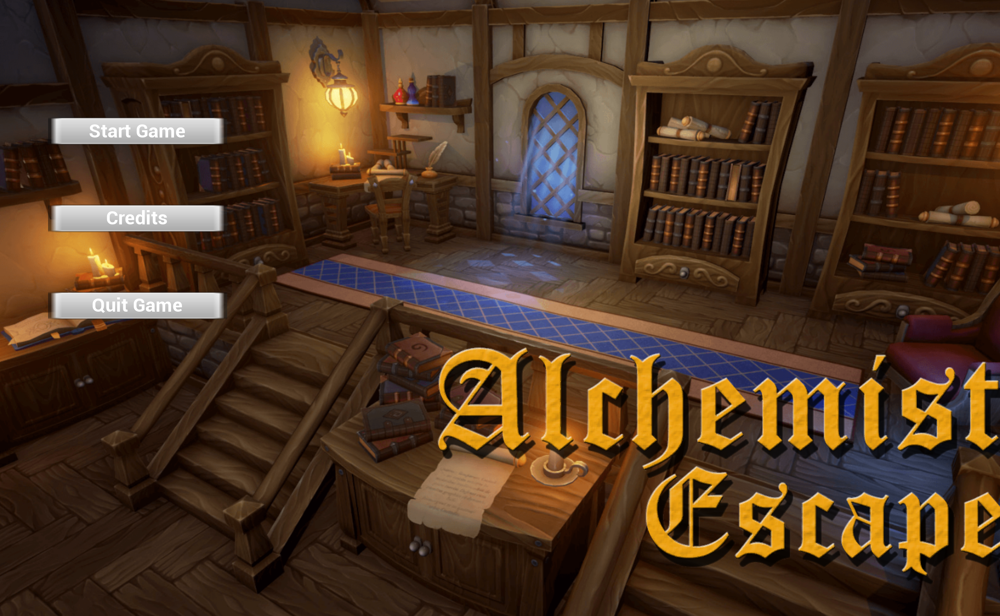
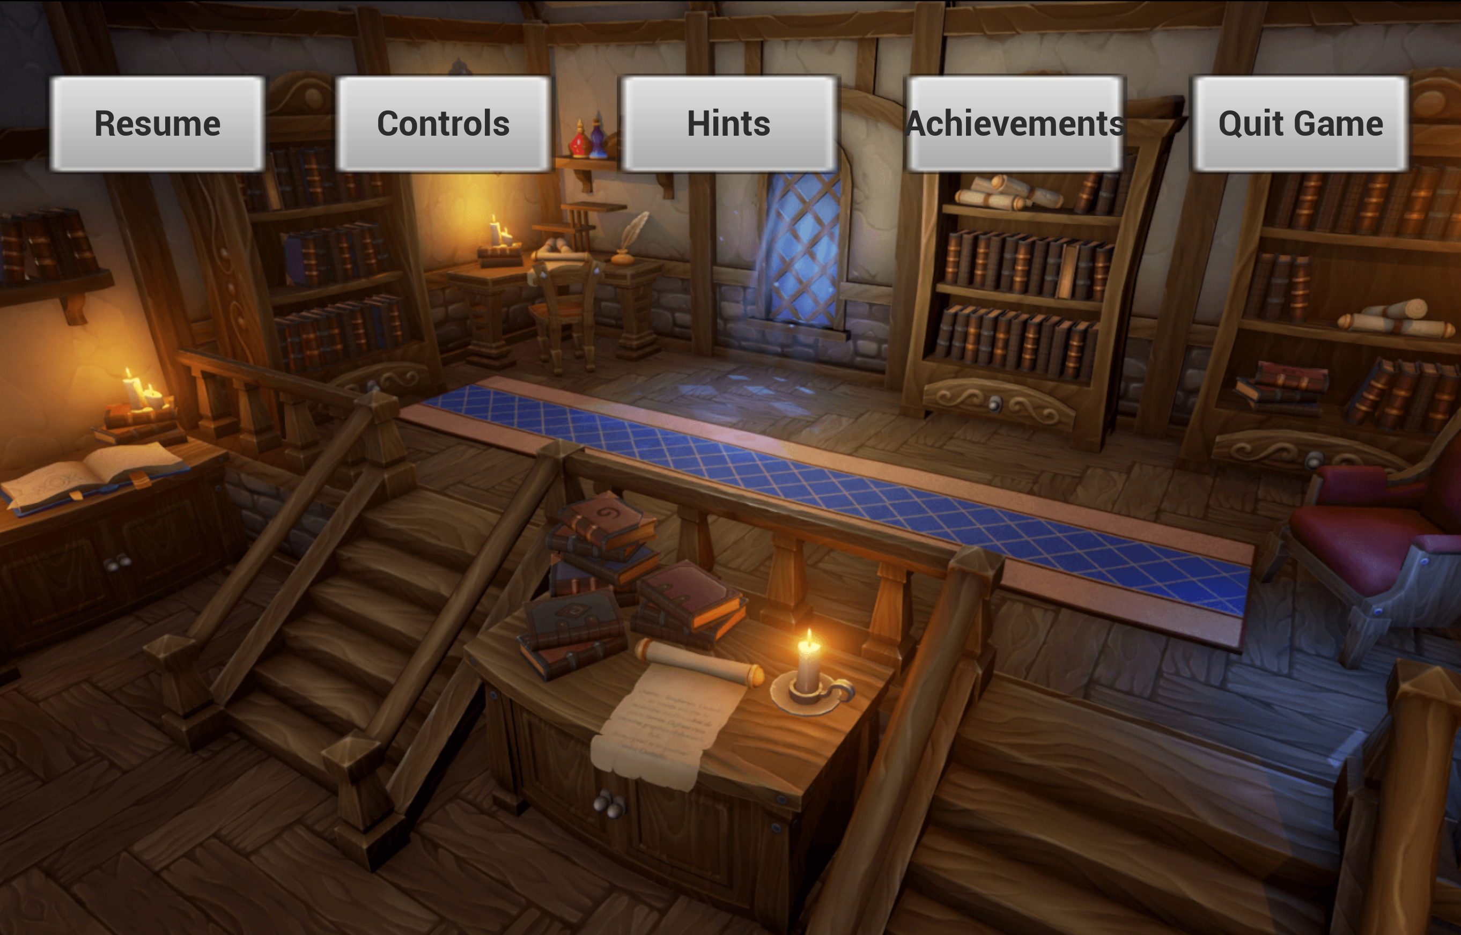
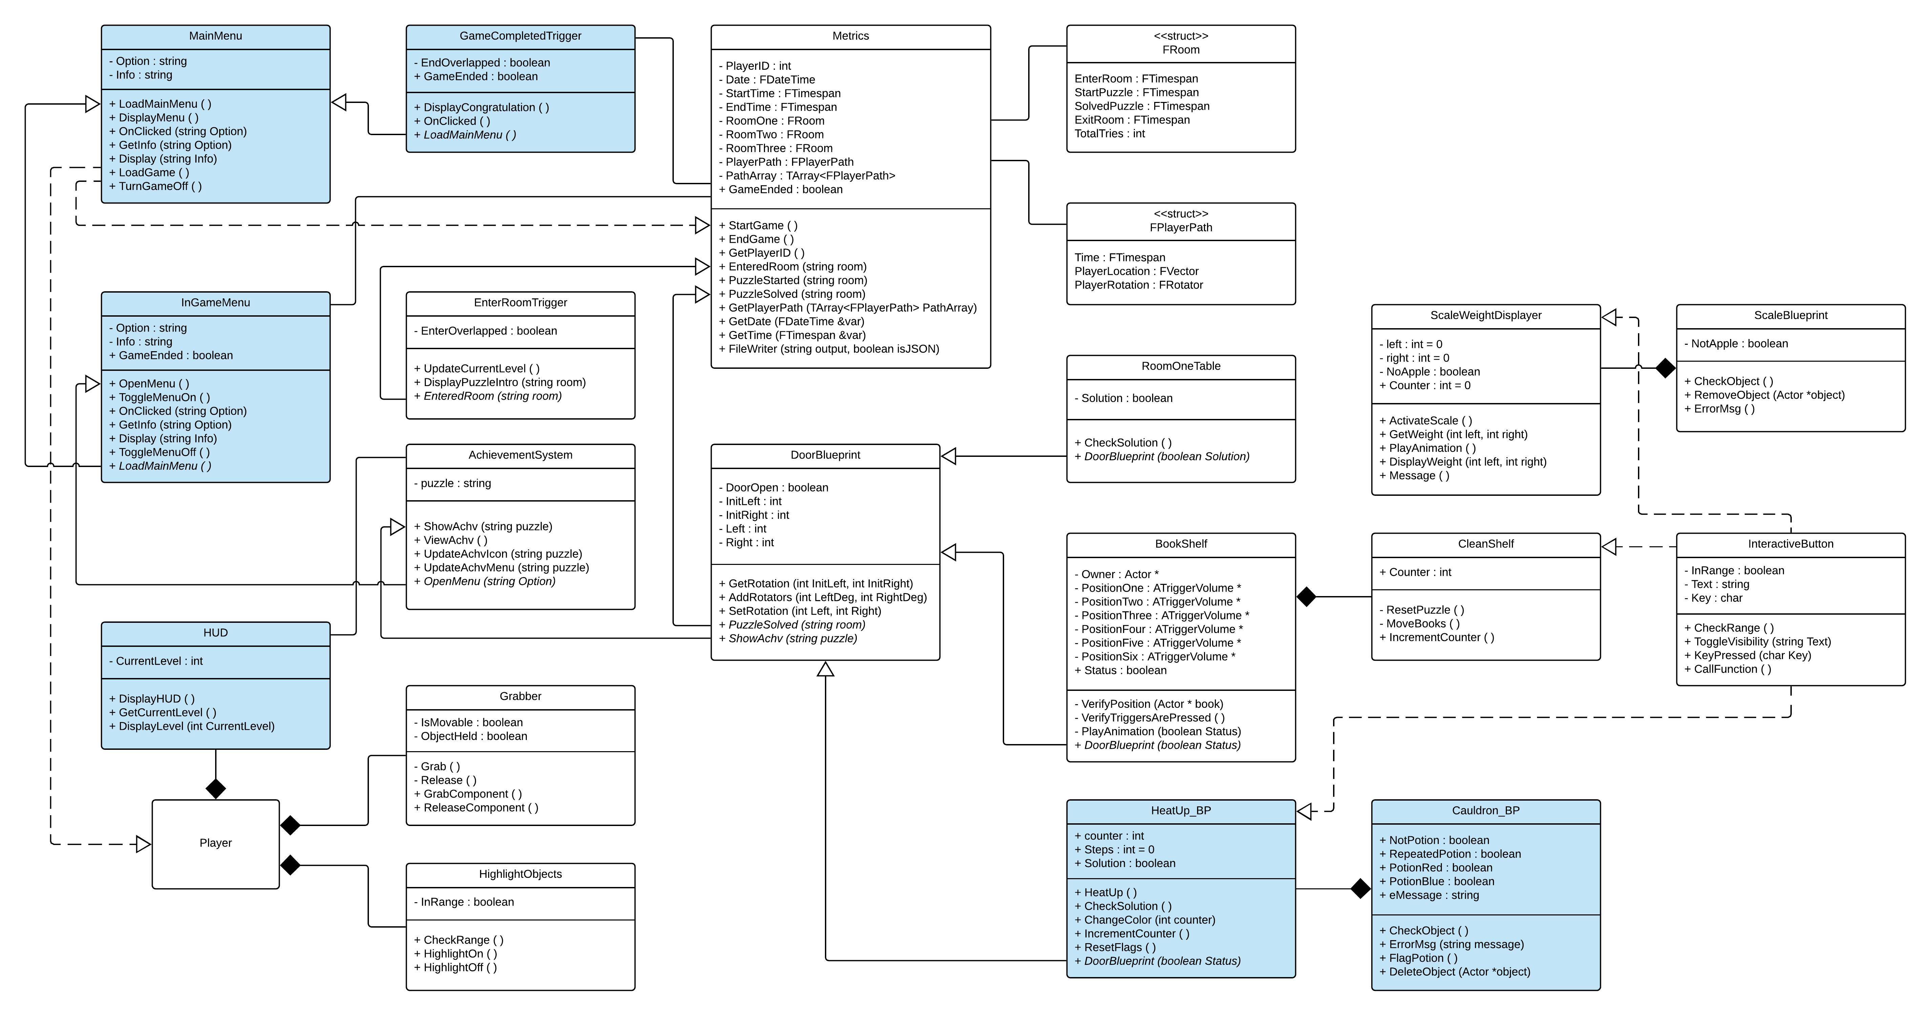
School of Computing & Information Sciences
VIP Senior, 2018, Spring
VR-Gaming to Broad Participation in CS 1.0
Student: Armando Carrasquillo Escobar, Florida International University
Mentor: Francisco Ortega, Florida International University
Professor: Masoud Sadjadi, Francisco Ortega, Florida International University
Problem
Data has shown that Computer Science(CS) professionals are on high demand. Unfortunately, data also shows that there is a low graduation rate, and low levels of interest from women and minorities like Black/African American and Hispanics. Attempts have been made to improve this imbalance, but they haven’t been effective.
Solution
The proposed solution to this issue is Alchemist Escape, a video game designed to increase awareness and interest in CS. The core concept of this game is to teach the player about CS concepts at a subconscious level through play. Research will be done on the player’s performance to improve future iterations of the game.
Current System
Current software and games that focus on either simulations or instructions are aimed to educate the player. Games with an educational purpose do not generate as much interest as games that focus on entertainment.
Puzzle Start: Door is Closed
Puzzle 3: For Loops
1st Loop
Puzzle Solved: Door Opens
2nd Loop
Requirements
Individual contributions:
Puzzle 3: Environment Creation
Puzzle 3: Object Collision Maps
Puzzle 3: Pressure Plates
Puzzle 3: Logic for Pressure Plates
Heads-up Display (HUD)
Main Menu
In-Game Menus
System Design
Implementation
Unreal Engine 4: The game is developed and executed on Unreal.
Blender & Photoshop: Used to alter objects or textures for the game.
C++ & Blueprints: The code used to implement the actions in the Unreal Engine.
JSON & Text Files: The data that the metrics collects from the user is stored in these file types.
Future Work
Add more puzzles to teach more concepts.
Expand VR functionality.
Port game to Mobile Devices.
Improve current game based on gathered metrics.
Use adaptive learning to better cater the puzzles to the player in real time.
Object Design
Summary
Created interactive experience that increases player interest in CS.
Designed for all skill levels.
Use game metrics to improve the game in later iterations.
Acknowledgement
The material presented in this poster is based upon the work supported by Dr. Francisco Ortega. I am thankful to the help that I received from my group members, Santiago Bolivar, and Daniel Perez. I am also thankful for my family and friends for their support!
FOLLOW US @FIUCIS
Notes:
1

